Slide 1

Virtual Private Networks

Slide 2
Part 1: “Practical” VPNs

Slide 3
Open issues
Collision domains are unsecure
Employees often need to remote access to corporate network resources
The Internet traffic is much more vulnerable to eavesdropping than the one that runs in an internal company network (think at a hotel wifi).
More remote offices may need to have access to the same resources
General privacy needs with respect to ISPs, Governments…

Slide 4
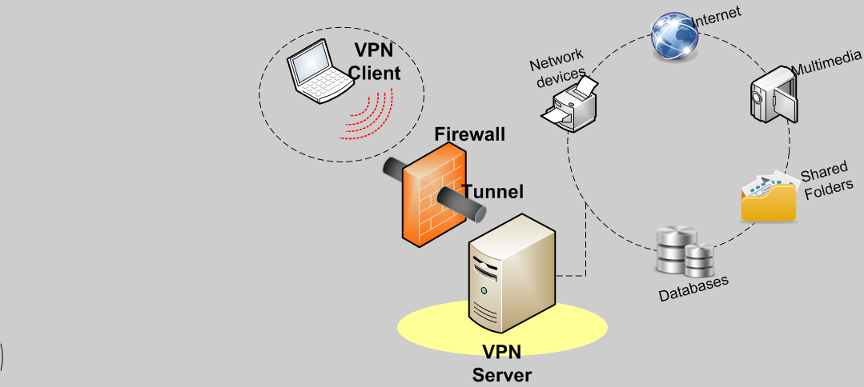
Solution
Idea: simulating a collision domain using an artificial underlying physical network (Internet) as the transmission media and, by means of a tunneling protocol, encapsulating the data to be transmitted (and possibly encrypting it)
Goal: get a transparent and secure subnet at low cost
a secure tunnel is created from the point of origin to the arrival
data can be transmitted both encrypted and signed

Slide 5
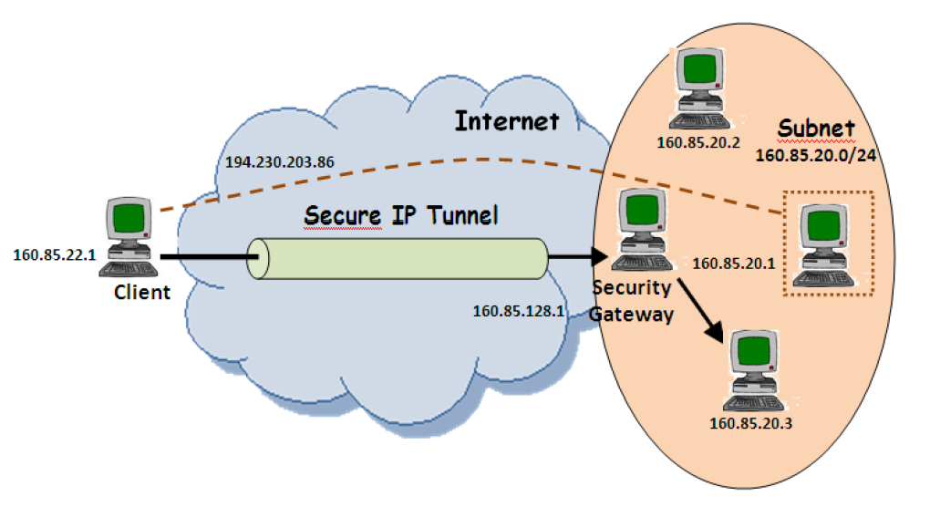
VPN for Roadwarriors

Slide 6
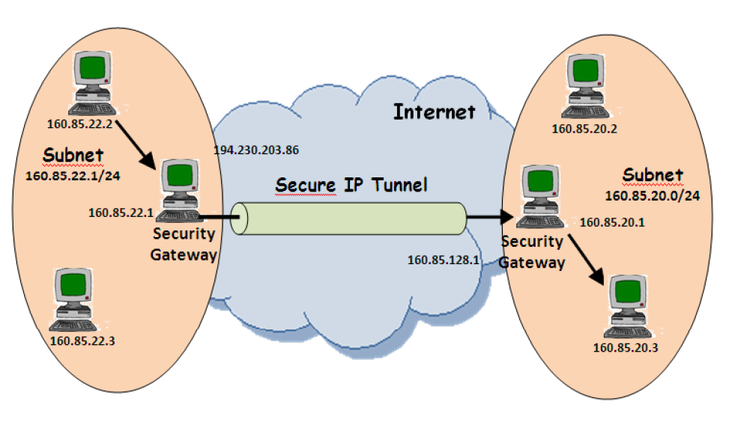
VPN LAN-2-LAN

Slide 7
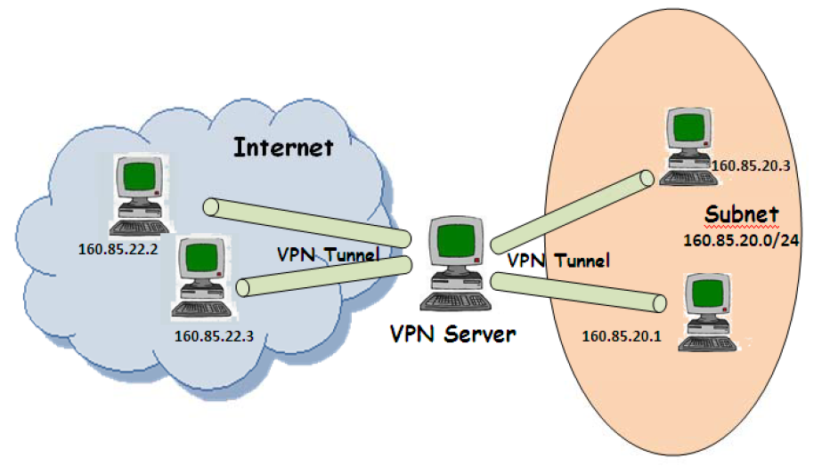

Many-to-many Secured VLAN

Slide 8
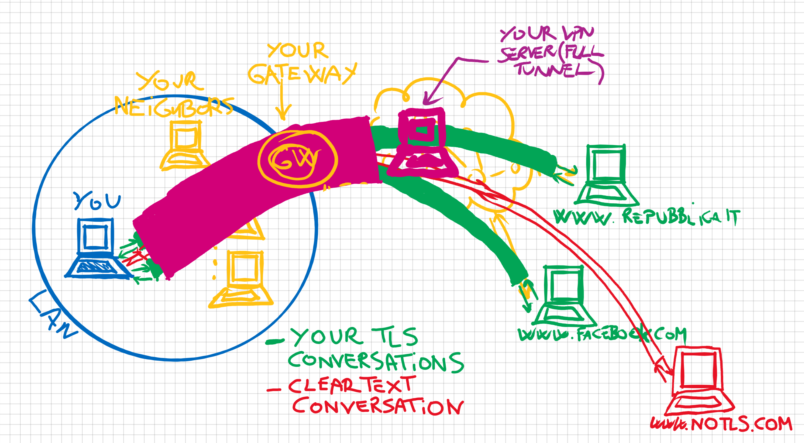
Other goals
Anonimity
Geographic proxying

Slide 9
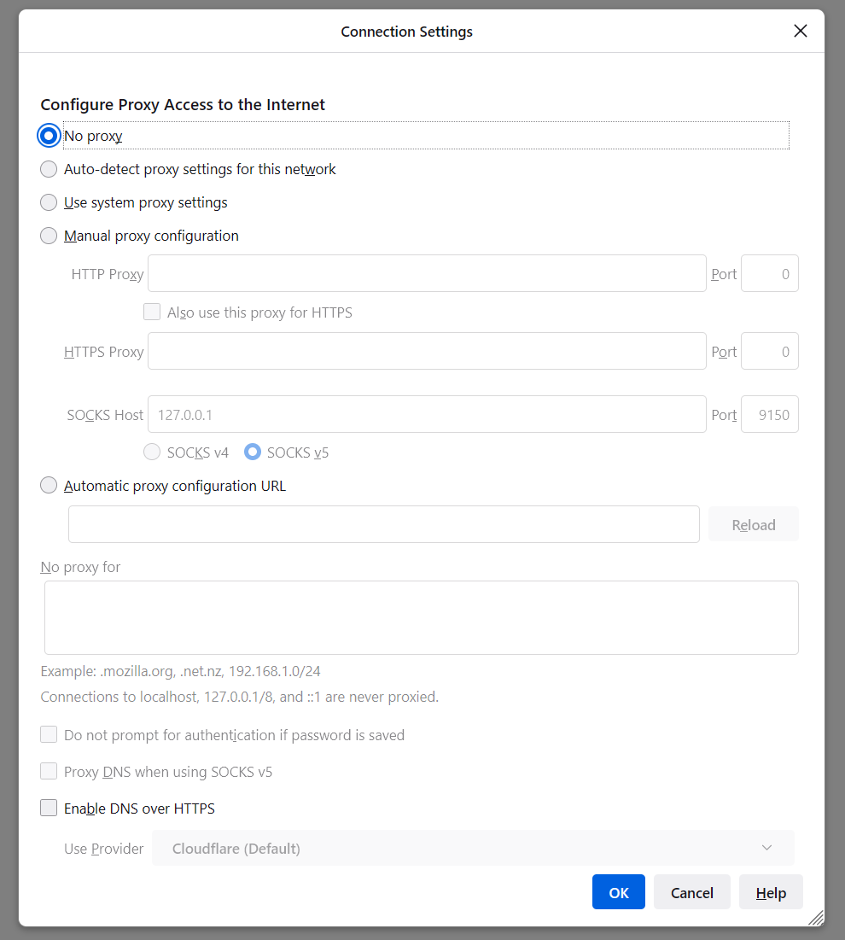
Alternatives
Layer 7 Proxying
Semi-transparent
(SOCKS5: applications must support it)
Nontransparent
(HTTP-based, with redirection)

Slide 10

VPN Ingredients
A VPN Server
A Tunneling protocol
Confidential
With integrity checks
A user authentication machinery
Must handle individual accounts
Virtual Network cards

Slide 11
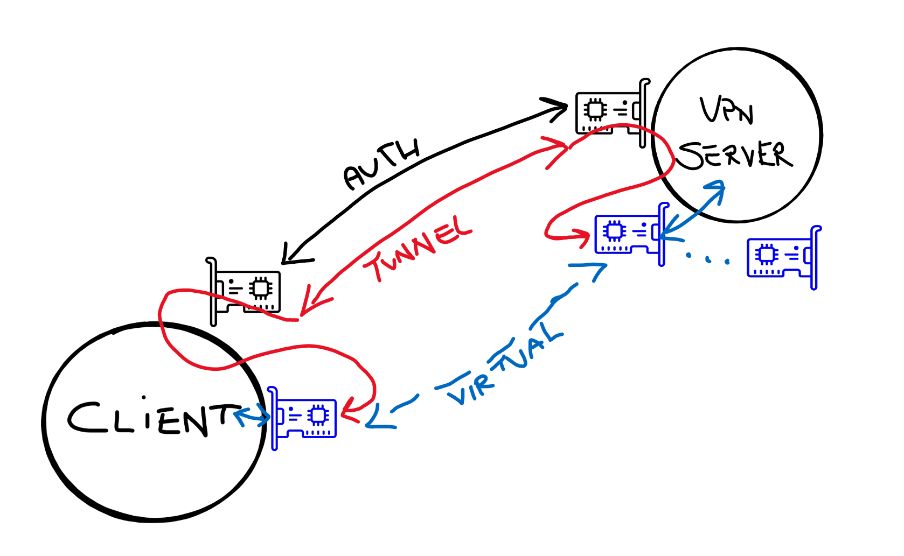
Virtual NICs

Slide 12
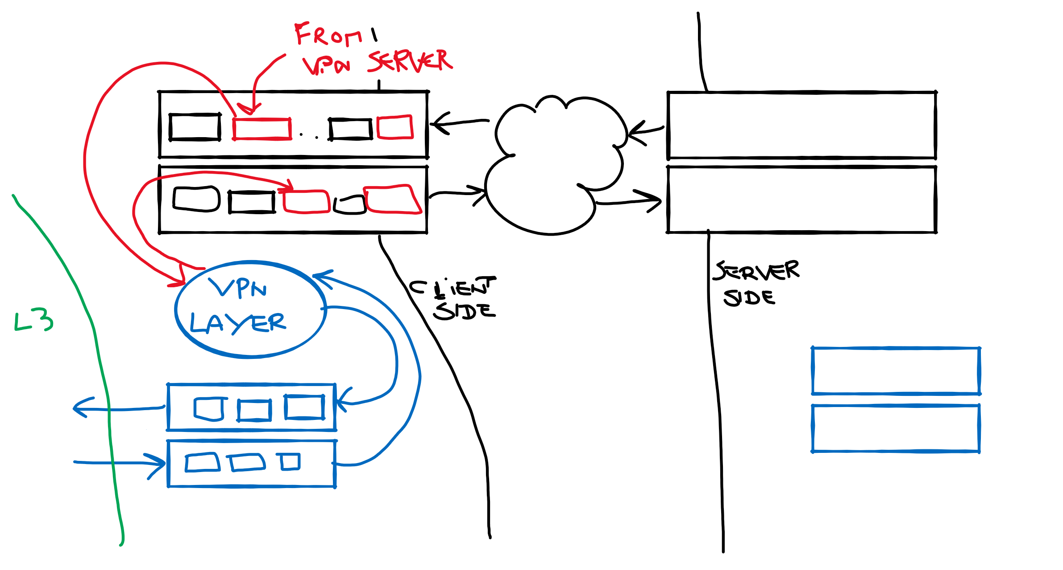
VPN Layer processing

Slide 13
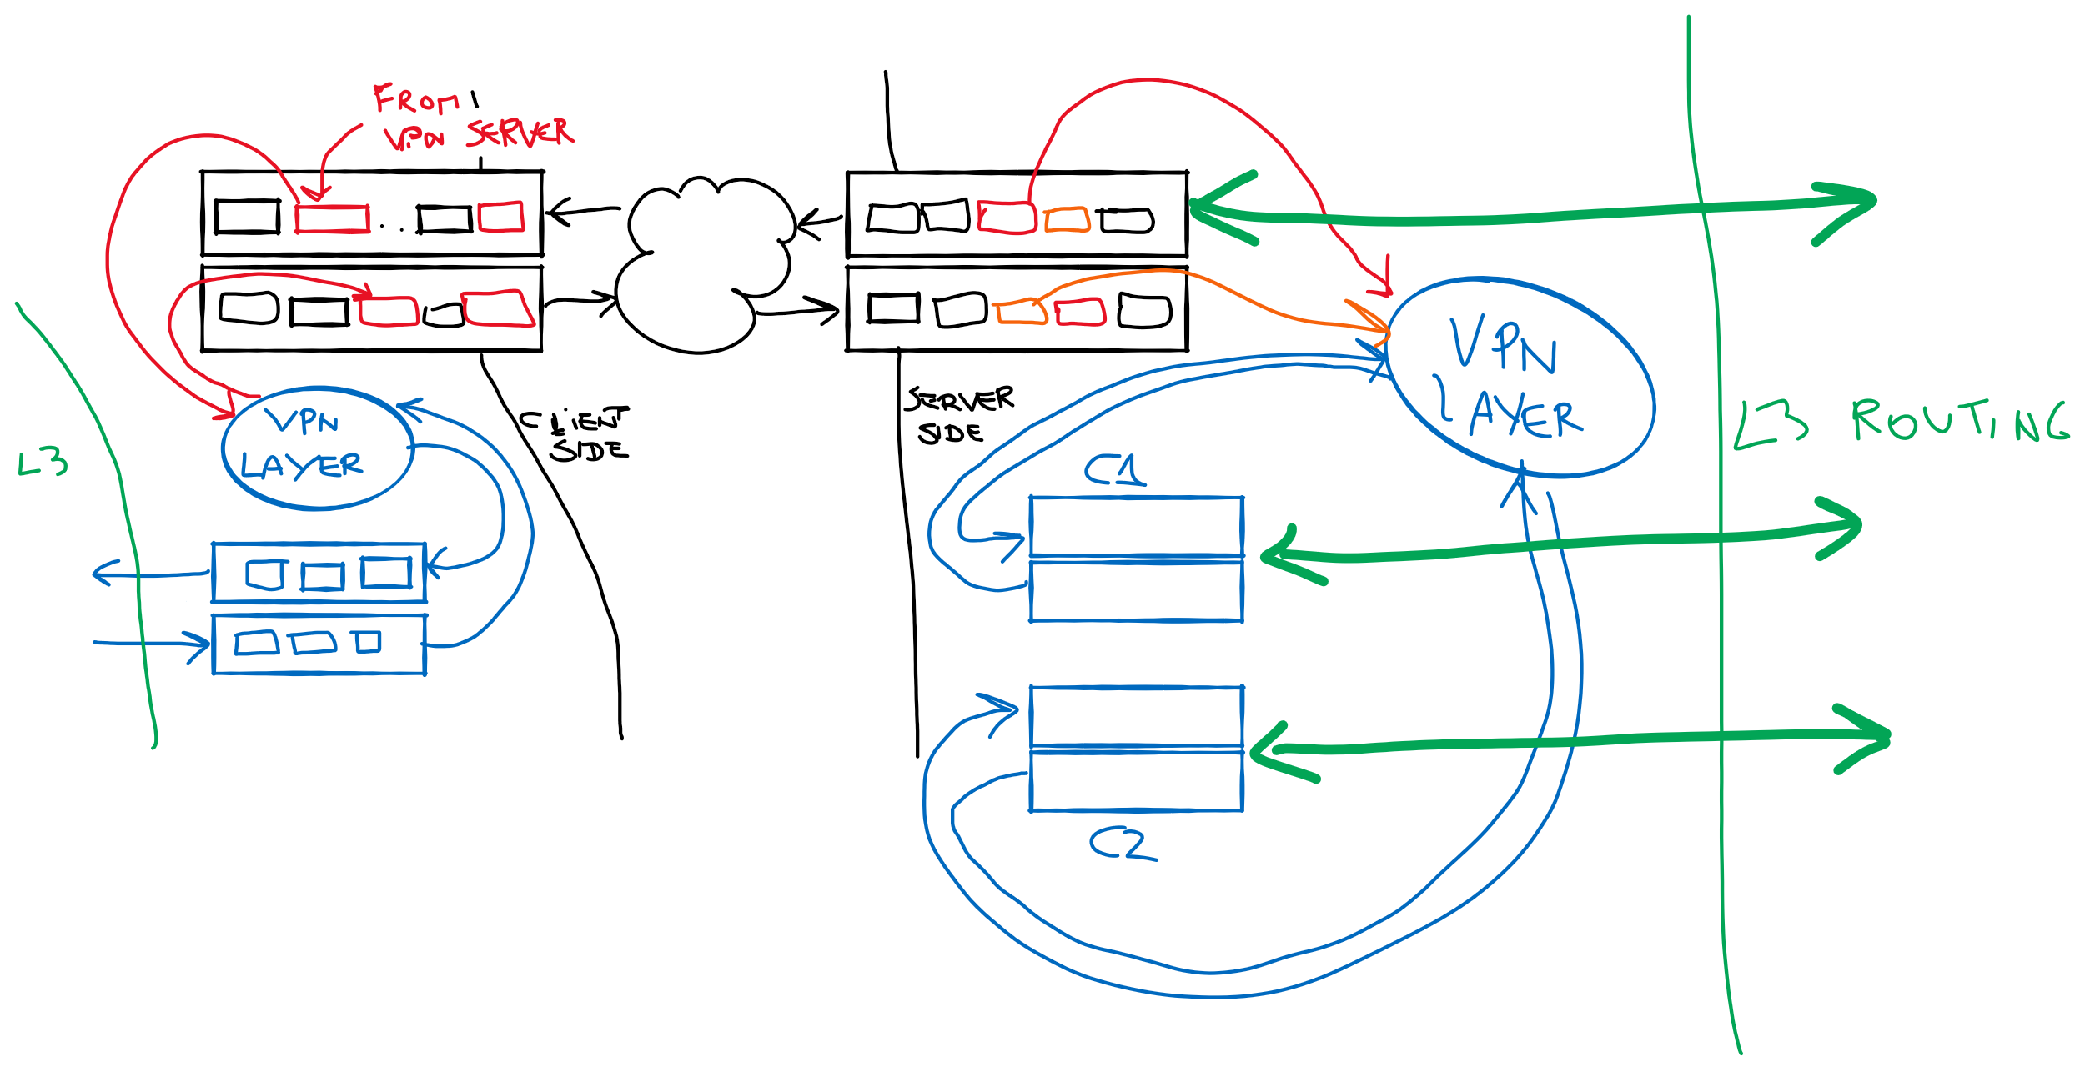
VPN Processing server side

Slide 14
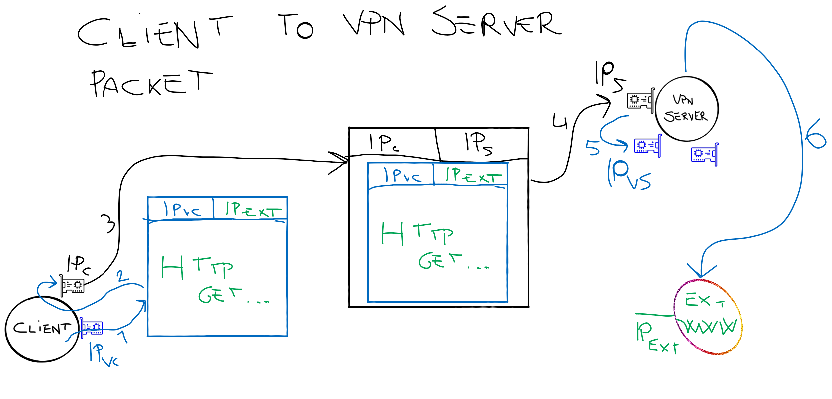
Tunnels: client to server VPN traffic

Slide 15
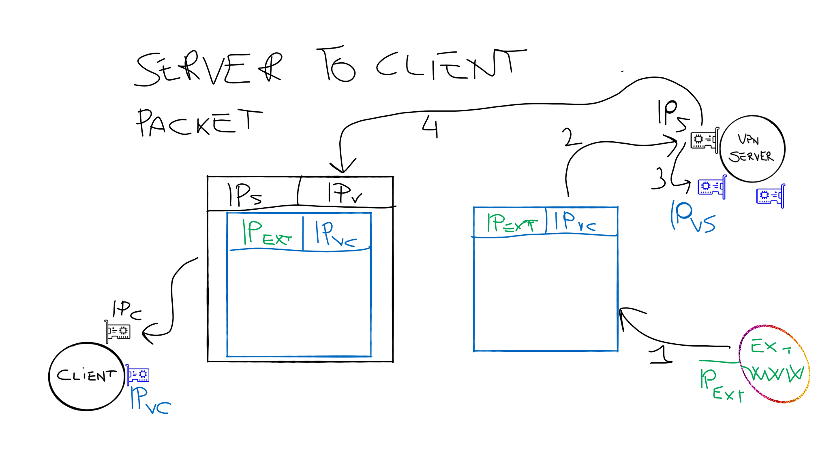
Tunnels: server to client VPN traffic

Slide 16
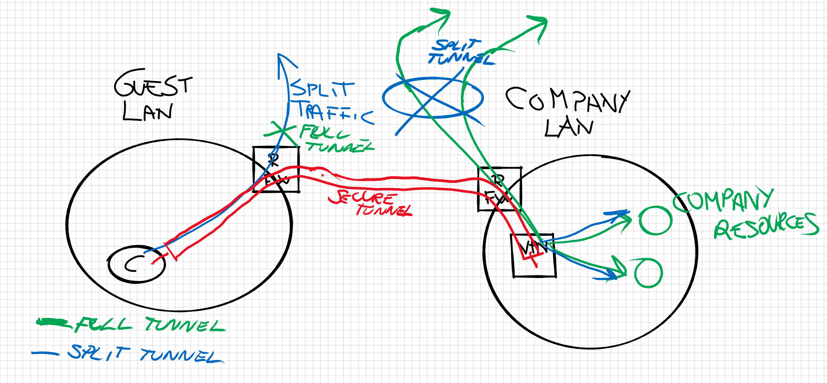

Full Tunnel vs Split Tunnel
Full Tunnel
the VPN server becomes the default gateway
Split Tunnel
Only some routes forward to the VPN server

Slide 17
Advantages of VPN
Cost reduction (for the use of the Internet)
Connecting remote locations without the costs of a dedicated line
Scalability
Add a potentially unlimited number of new sections or roadwarriors
Security and protection of data transmitted over the network
Possibility to access the corporate network users outside the company
Protocol independent, no need to support SSL at layer 4-7

Slide 18
Disadvantages
Overhead and loss of bandwidth
Configuration far from automatic
Vulnerabilities exist, VPNs are not the universal solution
«Tanto c’ho la VPN», «Tanto c’ho la mascherina»
ONLY the virtual link between client and VPN server is under protection

Slide 19
Secure VPN
Authentication mechanisms for the endpoints of the tunnel (during the setup of the tunnel)
Transit traffic encryption
The traffic is encrypted and this creates a "Tunnel" between two networks / hosts
The "Secure VPN" have one or more tunnels and each tunnel has two endpoints

Slide 20
Secure VPNs
To be called Secure, a VPN must provide:
an authentication system
the data must be transmitted under encryption and with signatures
Cryptography must be strong and can be rekeyed over time

Slide 21
Secure VPNs
Are used:
to protect the traffic when the Internet is the network of support or if the level of security offered by the underlying network differs from that required by domestic traffic to the VPN
In a remote access scenario, where a VPN client (end user) connects securely to a remote office network
For example, utilities offer remote access to employees of an organization

Slide 22
Secure VPNs
Technologies and protocols used (some non-standard IETF)
SSH Tunneling
SSL/TLS VPN (with SSL/TLS)
OpenVPN
PPTP/SSTP (with MPPE).
IPsec ‘pure’
Ipsec+L2TP+IKEv2

Slide 23
Obstacles to VPN deployment
TCP Tunnels : Head of the line blocking
Sequence numbers are a trouble
GRE and IPSec are not NAT friendly
IPSec over UDP is OK, but with smaller MTU

Slide 24
Security Protocols (Secure VPN)
Ipsec (Internet Protocol Security)
Developed for IPv6, but also used for IPv4
Introduction of security
Traffic encryption: traffic read only by target
Integrity
Authentication of peers

Slide 25
Security Protocols (Secure VPN)
IPsec (Internet Protocol Security)
Standard
Encapsulating Security Payload (ESP): provides authentication, confidentiality and integrity check of the message;
Authentication Header (AH): ensures authentication and integrity of the messagebut does not offer the confidentiality;
Internet key exchange (IKE): implements "exchange keys" to realize the encrypted stream;
AH authenticates the complete package, instead ESP authenticates data only.

Slide 26
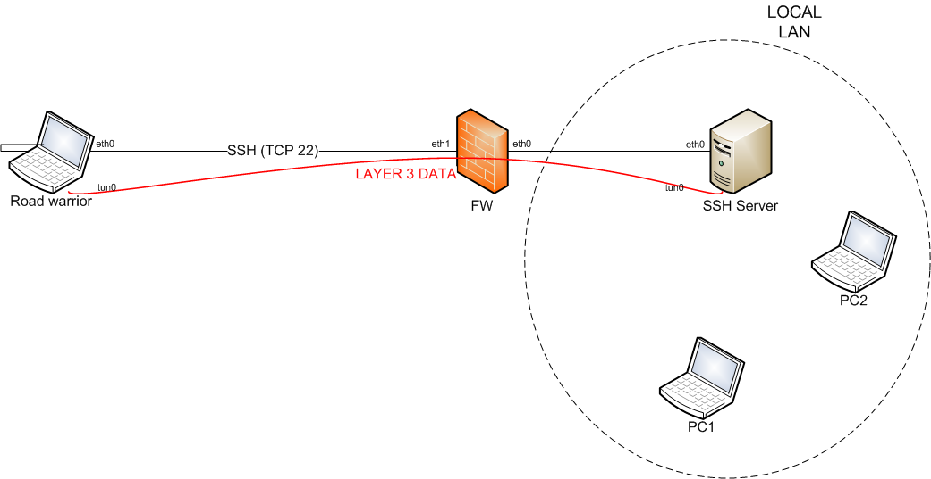
VPN with SSH Tunnel
iptables –A FORWARD –i eth1 –d ssh.server –p tcp –dport 22 –j ACCEPT
iptables –A FORWARD –i eth0 –p tcp –sport 22 \
–m state –state ESTABLISHED, RELATED–j ACCEPT

Slide 27
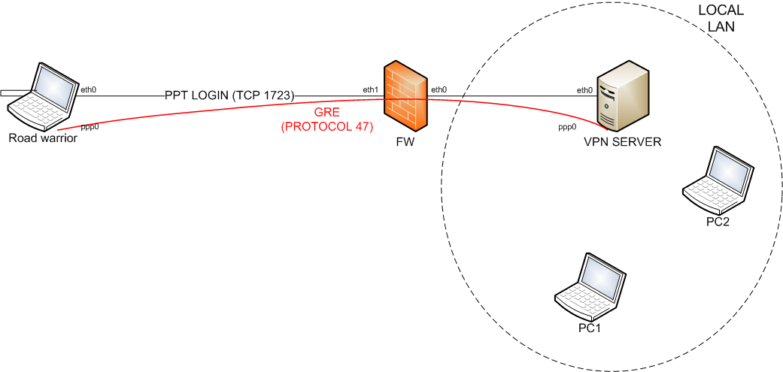
VPN PPTP+GRE
iptables –A FORWARD –p 47 –d vpn.server –j ACCEPT
iptables –A FORWARD –i eth1 –d vpn.server–p tcp –-dport 1723 –m state –state ESTABLISHED, RELATED–j ACCEPT
iptables –FORWARD –eth0 –p tcp –-sport 1723 \ –m state –state ESTABLISHED, RELATED–j ACCEPT

Slide 28
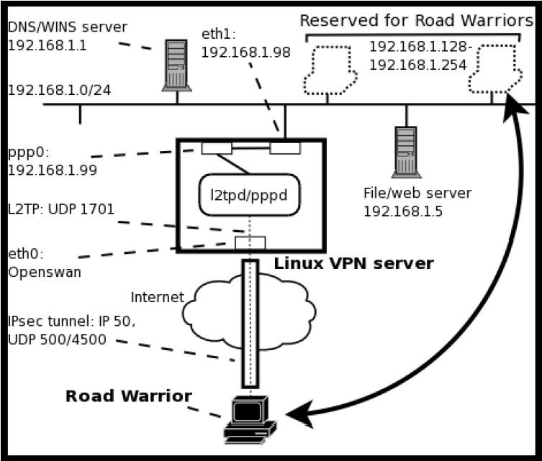
Tunneling with IPsec
iptables –A FORWARD –p esp –j ACCEPT
iptables –A FORWARD –i eth1 –p udp –-dport 500 \
–m state –state ESTABLISHED, RELATED–j ACCEPT
iptables –A FORWARD –i eth0 –p udp –-sport 500 \
–m state –state ESTABLISHED, RELATED–j ACCEPT

Slide 29
Virtual links: other technologies
Protocols used for the Tunneling:
L2TP (Layer 2 Tunneling Protocol)
MPLS (Multi-Protocol Label Switching)
GRE (Generic Routing Encapsulation)
PPTP(Point-to-Point Tunneling Protocol)
Ipsec
IEEE 802.1Q (Ethernet VLANs)

Slide 30
Tunneling: other technologies
Point to Point Tunneling Protocol (PPTP) | Developed by Microsoft, is a Point to Point Protocol (PPP) extension that encapsulates IP, IPX, NetBEUI into IP packets
Layer 2 Forwarding (L2F) | Developed by Cisco, used for the “tunneling” of link protocols
Layer 2 Forwarding Protocol (L2TP) | Created with an agreement to Microsoft and Cisco, allows the “tunneling” of PPP traffic on several networks. Gives a multi-protocol dial-up service for ISP and POP provider. As L2F, L2TP does not provide encryption.
Socksv5 | L2TP alternative developed by Nec

Slide 31
Security Protocols (Secure VPN)
Transport Layer Security (SSL/TLS)
Can be used for tunneling the entire network traffic (SSL/TLS VPN) or to make it secure a individual connection
SSL (essential for providing remote access to VPN services)
Advantage of SSL VPN is that it can also be accessed from locations that restrict access to SSL-based Web sites without the support of IPsec.
SSL-based VPNs may be vulnerable to denial-of-service targeted to TCP connections, being unauthenticated
Ensures confidentiality and reliability of communications over a public network
Protects from intrusion, alteration or falsification

Slide 32
Security Protocols (Secure VPN)
Datagram Transport Layer Security (DTLS)
Cisco AnyConnect VPN.
DTLS resolve the HOL problem on TCP
Microsoft Point-to-Point Encryption (MPPE)
Used with PPTP
PPTP (point-to-point tunneling protocol):
Data encryption
Developed by Microsoft, ensures authentication, encryption and compression of data
Generic Routing Encapsulation (GRE): GRE creates a virtual link point-to-point and this is done in a way that none of the two ends have to worry about the infrastructure on which the communication passes

Slide 33
Security Protocols (Secure VPN)
Secure Socket Tunneling Protocol (SSTP) (Microsoft)
Windows Server 2008, Windows Vista Service Pack 1.
SSTP tunnels PPP o L2TP traffic via a SSL 3.0 channel
MPVPN (Multi Path Virtual Private Network)
Developed by Ragula Systems Development Company
SSH VPN -- OpenSSH
Provides VPN tunneling to ensure secure remote connections to a network

Slide 34
Security Protocols (Secure VPN)
L2TP (Layer 2 Tunnelling Protocol)
Secure/Trusted VPN
Standard IETF
Is a layer 5 protocol (session) that works as a layer 2 protocol (data link) using UDP packets to encapsulate L2TP packets and to maintain a Point-to-Point connection.
Has to be combined with another protocol to implement authentication, confidentiality and integrity of data (usually IPSec).
L2TPv3 (Layer 2 Tunnelling Protocol version 3)
Secure/Trusted VPN
Evoluzione di L2TP creato come alternativa a MPLS

Slide 35
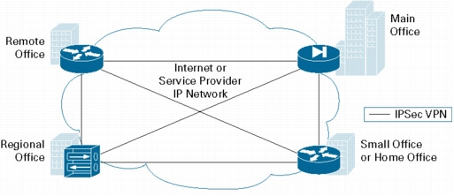
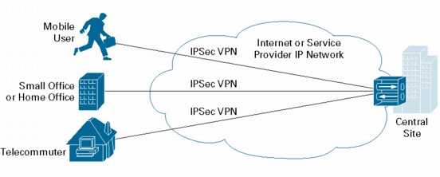
IPSec based VPN
Data confidentiality: Encrypts packets before transmission (ESP)
Data integrity: Authenticates packets to help ensure that the data has not been altered during transmission
Data origin authentication: Authenticates the source of received packets, in conjunction with data integrity service (Internet Key Exchange protocol)
Antireplay: Detects aged or duplicate packets, rejecting them

Slide 36
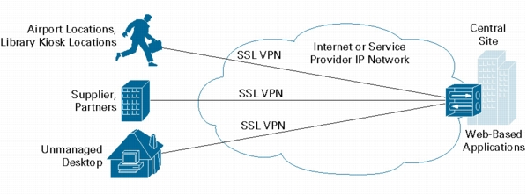
SSL-based VPN
Alternative to IPSec for remote-access VPNs
SSL provides access special client software
Secure connectivity by authenticating the communicating parties and encrypting the traffic
SSL operates at the session layer and doesn’t not support applications not coded for SSL
SP can provide granular access control, limiting individual users' access to resources
Include application proxies (SSL must be aware of each individual connection )
SSL is computing-intensive (encryption processes )

Slide 37
Authentication
The tunnel endpoints have to authenticate before establish a secure VPN circuit
Tunnel End user-created can use passwords, biometrics, two-factor authentication, other encryption methods
Network-to-network tunnels using passwords or digital certificates, since it must be stored permanently and does not require manual intervention for the activation of the tunnel.

Slide 38
Part 2: “General” VPNs

Slide 39
What is a Virtual Private Network in the broad sense
The term is generic, it can describe different configurations of networks and protocols ...
Virtual: it is an artificial network that relies on an underlying physical network
Private: data is transmitted encapsulated and ensuring some form of confidentiality
It works as a “pipe within a pipe” where the outside is formed by the connection of the underlying network
Internet can be used as a communication platform
Establishes the logical channels that are totally logic and safe between sections

Slide 40
Classification (based on ...)
Type of Tunneling protocol
Localization of the "tunnel termination“
user side (LAN) or network provider
Access type
site-to-site, remote access connectivity
Guaranteed security level
OSI layer that is exposed to the network connection
Layer 2 circuits, Layer 3 network connectivity

Slide 41
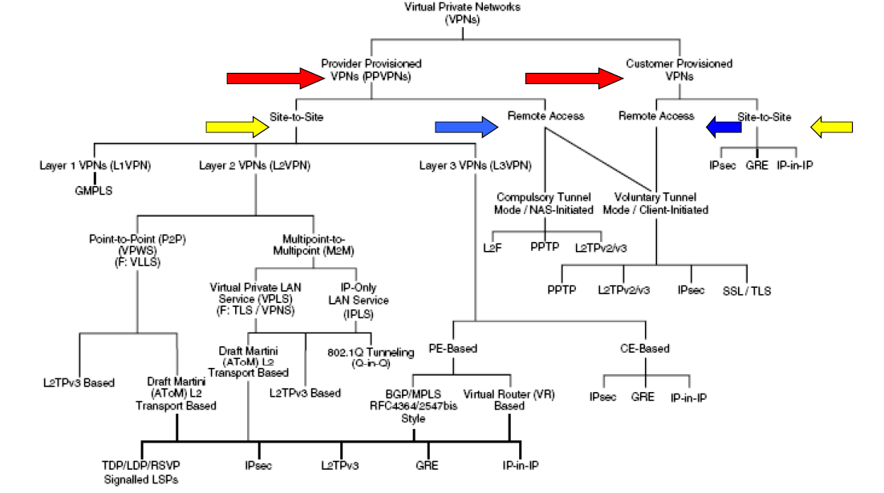
Classification

Slide 42
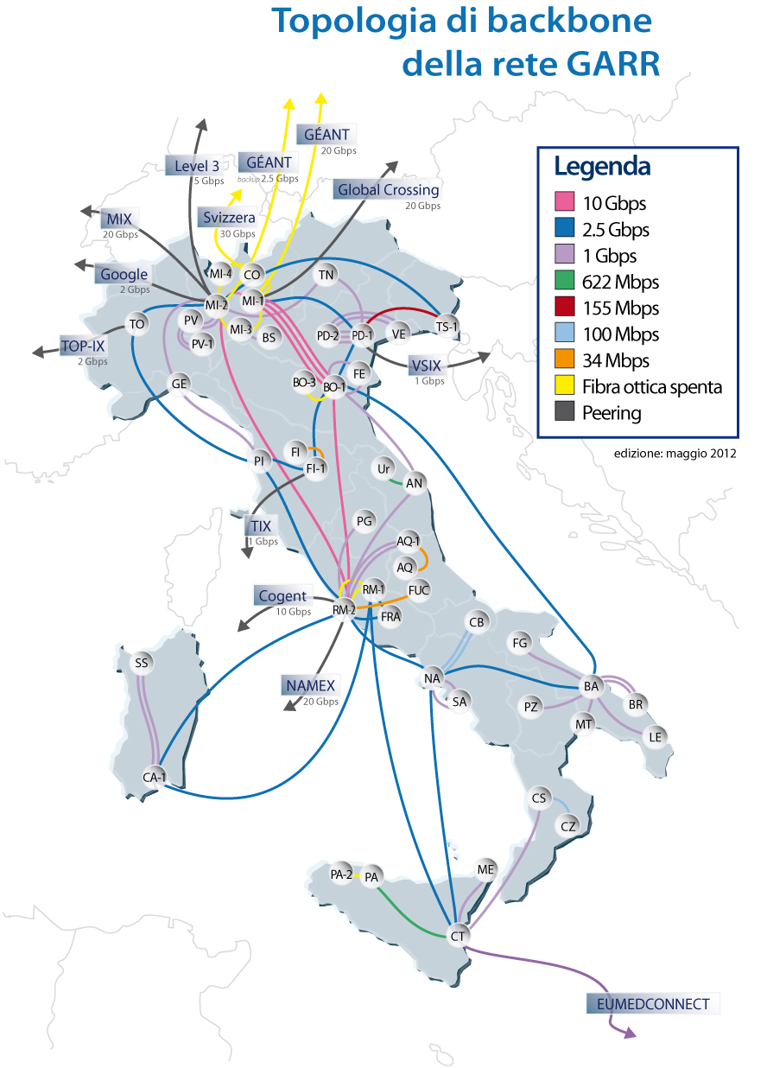
GARR network

Slide 43
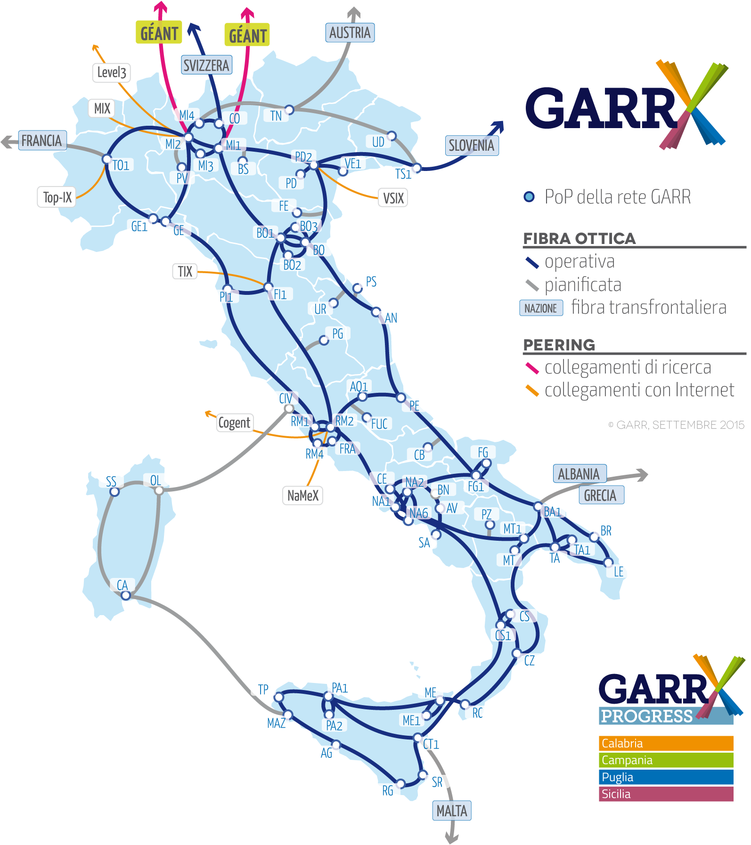

Slide 44
Traditional classification
Intranet VPN: connecting remote offices or locations of a company
Remote access VPN: connect head office of a company with remote or mobile users
Extranet VPN: connect the central office with partners, customers, suppliers
Intranet VPN: information security, performance of responses, scalability
Remote VPN access: strong authentication, efficient system of centralized account management
Extranet VPN: use of standard and open platforms

